Slide 1
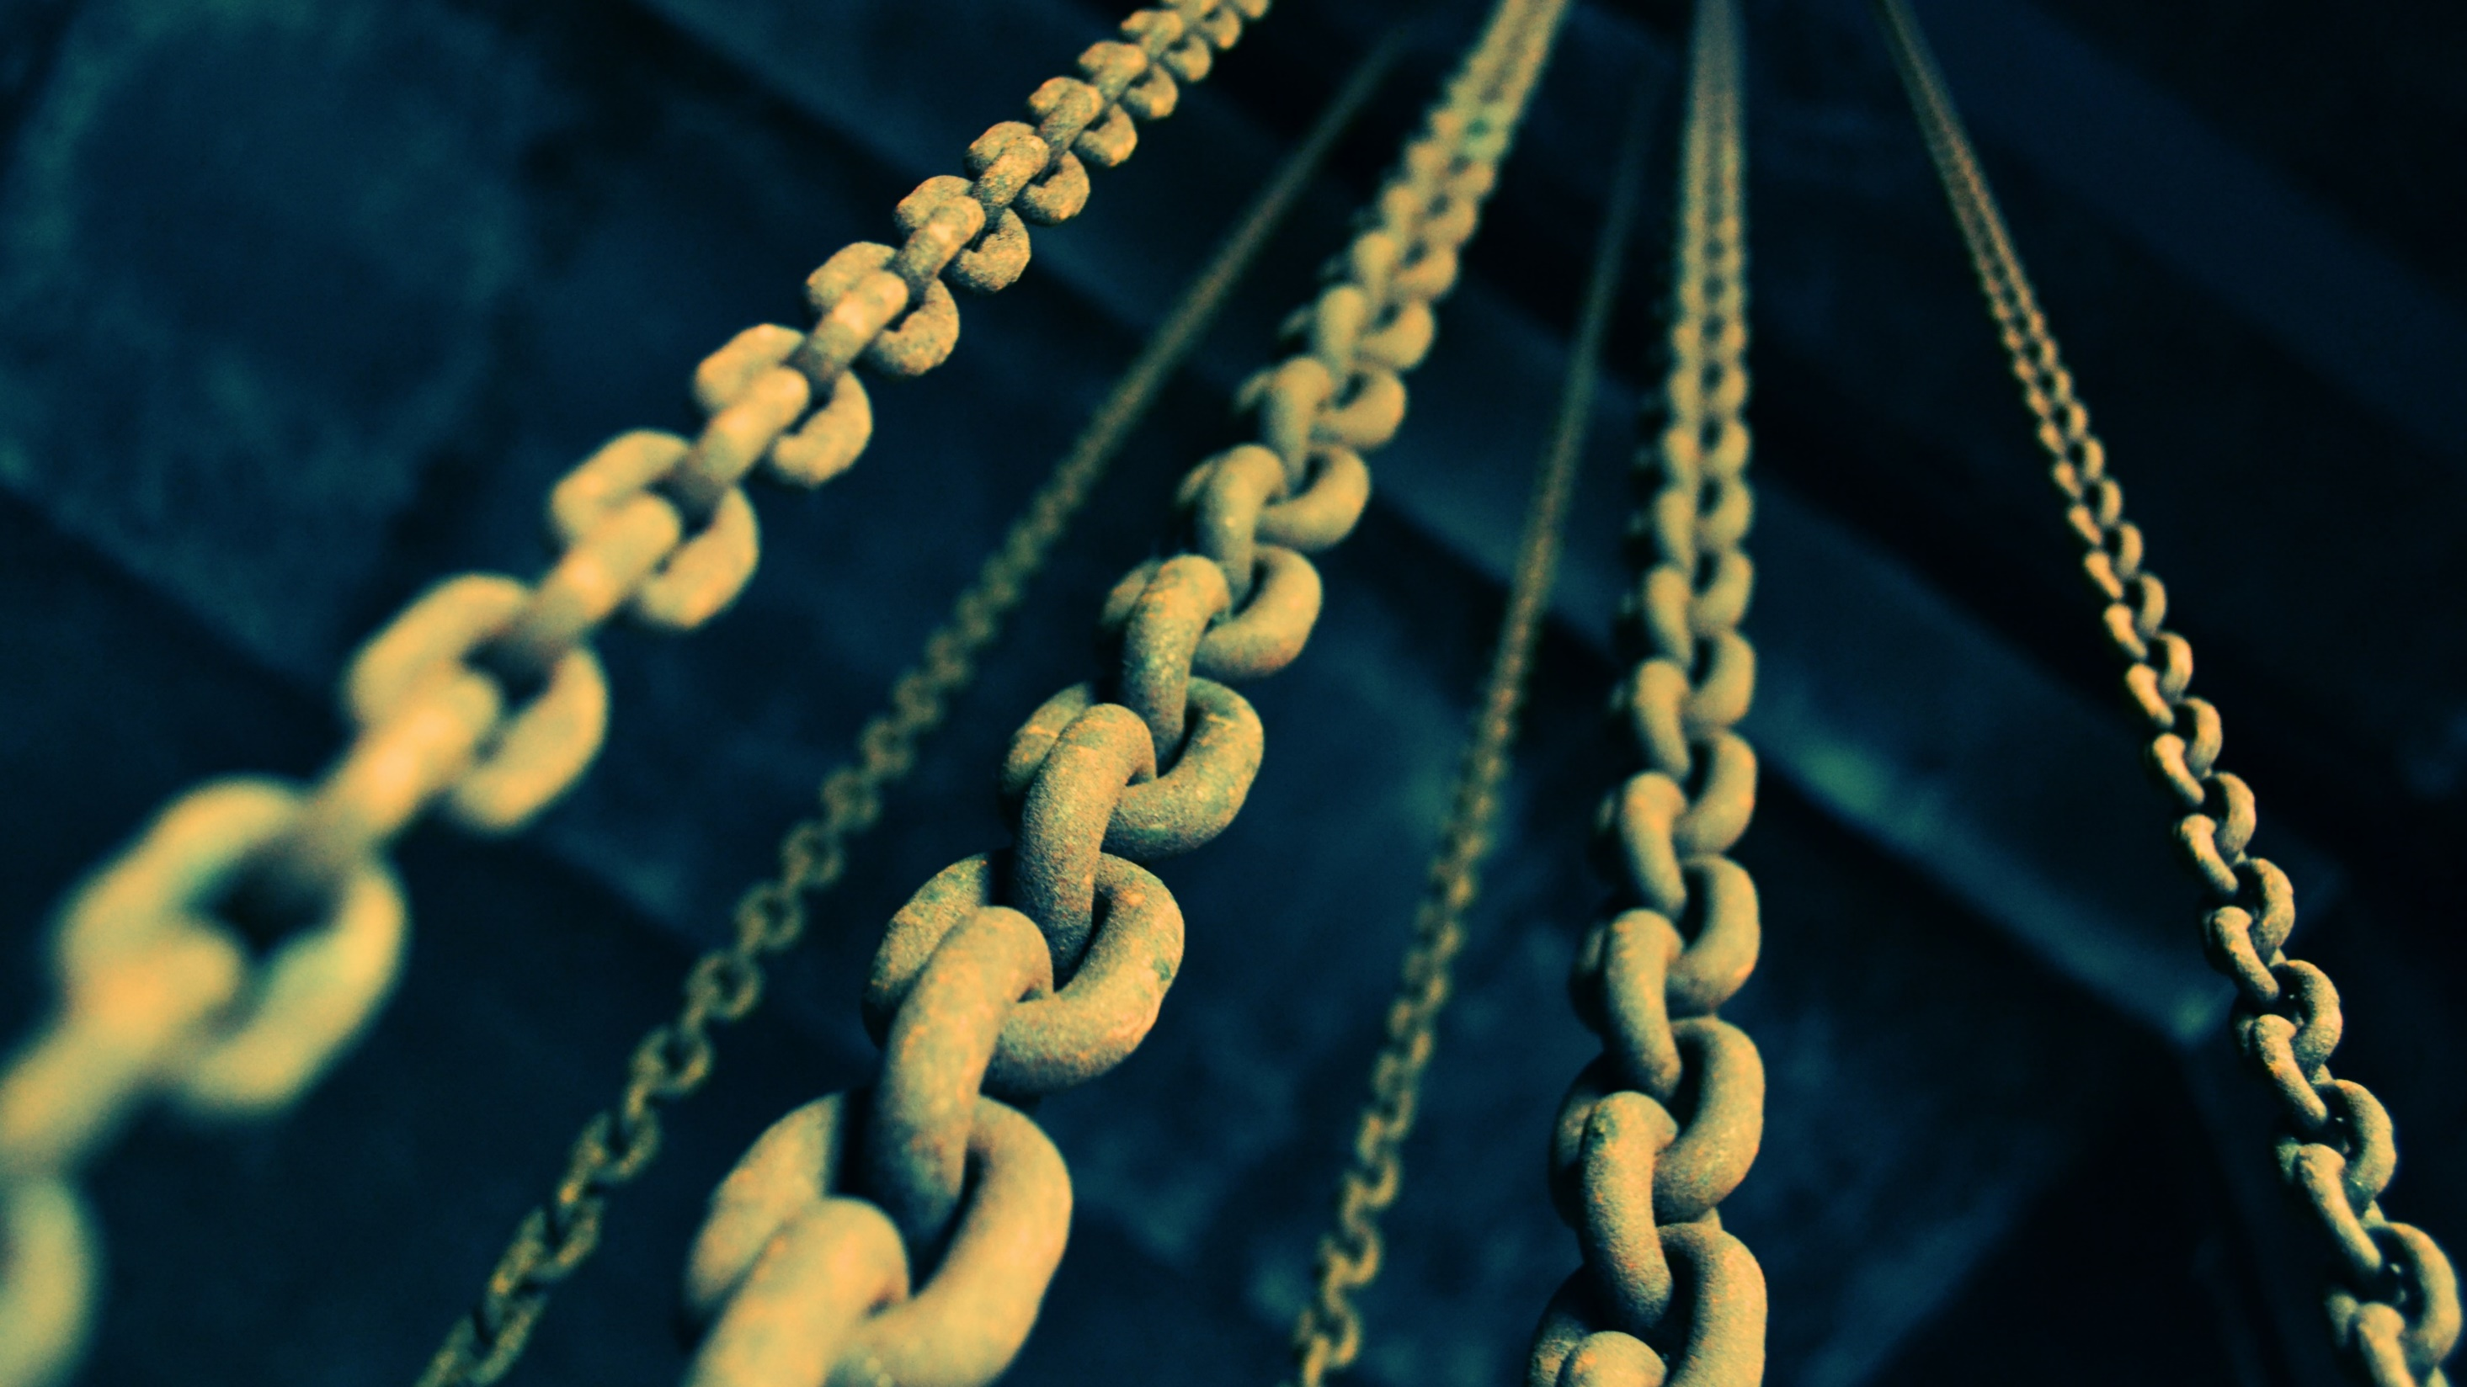

Blockchain & Distributed Ledgers
CorkSec, 2018-04-10
Johannes Ahlmann, CTO @ iLen
johannes.Ahlmann@ilen.io
iLen.io

Slide 2


Agenda
1) High-Level Overview
2) Deep Dive
images:
https://www.biggerpockets.com/renewsblog/2014/07/18/high-level-overview-literally-30-unique-real-estate-markets-around-world/
https://codeburst.io/deep-dive-into-electrons-main-and-renderer-processes-7a9599d5c9e2

Slide 3

1) High Level Overview
images:
https://www.biggerpockets.com/renewsblog/2014/07/18/high-level-overview-literally-30-unique-real-estate-markets-around-world/

Slide 4










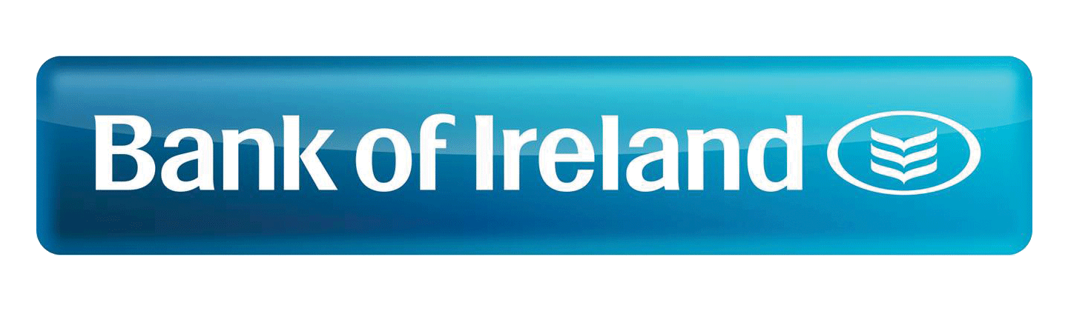









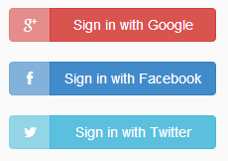







When we interact/transact with others, we often delegate Trust to Intermediaries
producer,
provider,
seller,
lender
consumer,
recipient,
buyer,
borrower

Slide 5
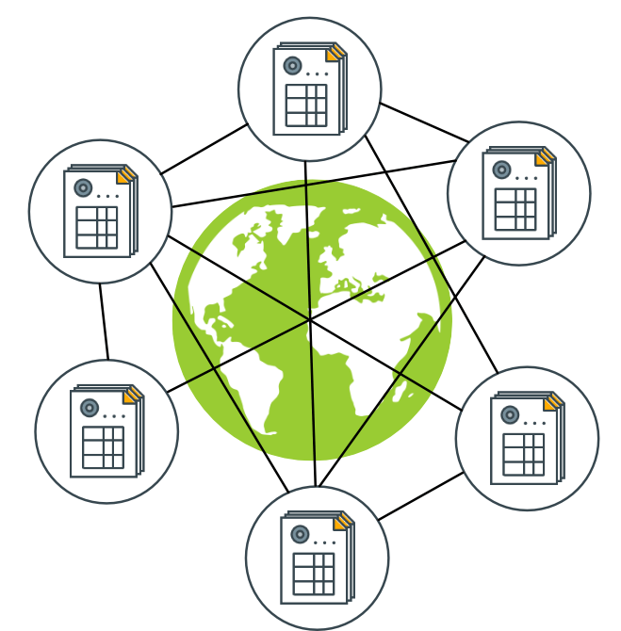
If we had a trusted Shared Ledger many of those Intermediaries would no longer be necessary
Shared, distributed Ledger
Immediate Consensus on "State of the World"
Tamper-Proof
Public, anyone can access, validate
Transactions change the state
sources:
https://commons.wikimedia.org/wiki/File:Server-based-network.svg
http://www.gjermundbjaanes.com/img/posts/distributed_ledger.png

Slide 6
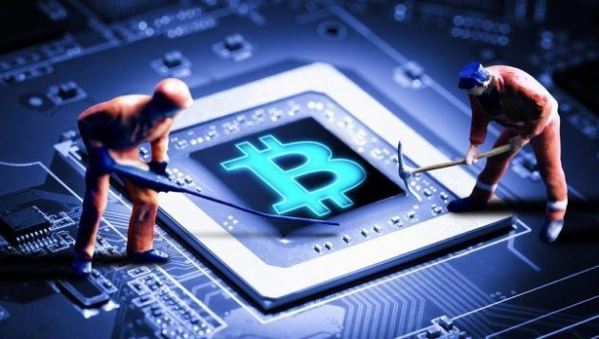
How can we achieve a shared, trusted Ledger without Trust between Parties?
Block = List of Transactions
Blockchain = Chain of Blocks
Tamper-Proof
Consensus (PoW)
Miners expend energy to find hash puzzle solution
Other nodes accept block if it is valid
Trustless
Nodes assumed to be untrusted
Fair Lottery, Cryptography ensure that no one can cheat
prev: H( )
prev: H( )
prev: H( )
tx
tx
tx
tx
tx
tx
tx
tx
tx
tx
tx
tx
tx
tx
tx
source: https://medium.com/@brettking/abc61b2ab49a

Slide 7
A Consortium Blockchain can address some Challenges Companies may find with Public Blockchains
Public | Consortium
Data is Public | Privacy, Confidentiality
Transactions are Public | Private Channels
Pseudonymous | Known participants
Anyone can join | Permissioned
Anyone can access | Permissioned
Trustless Nodes | Semi-Trusted Nodes
Low tx/s | High tx/s
 | GDPR Compliance
Group of known, semi-trusted parties
Access granted by members
Consensus ~ majority vote (BFT)
Consensus can withstand 1/3 of malicious nodes
Easier Governance

Slide 8
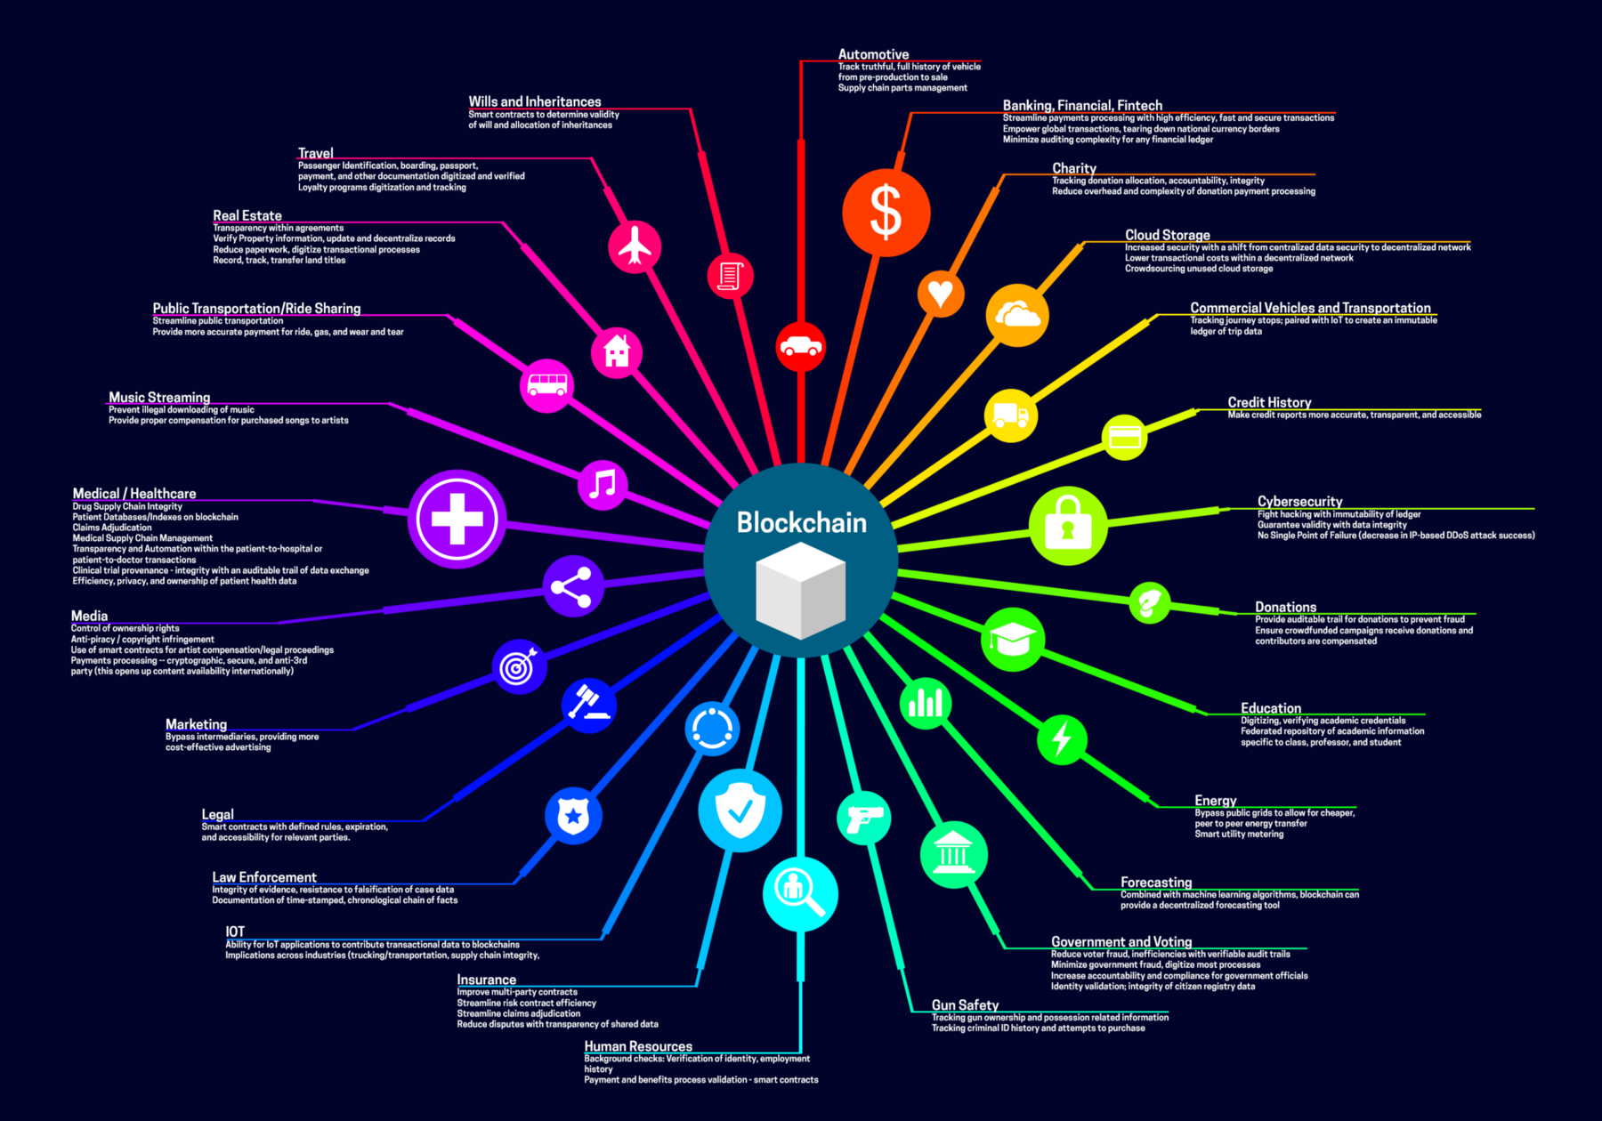
What are some of the Blockchain Use Cases for Companies?
Data Exchange between multiple parties
End-to-End Supply Chain Transparency
Product Traceability
Marketplaces, Trading
Clearance & Settlement
Public Registries
source: https://medium.com/fluree/blockchain-for-2618-and-beyond-a-growing-list-of-blockchain-use-cases-37db7c19fb99

Slide 9
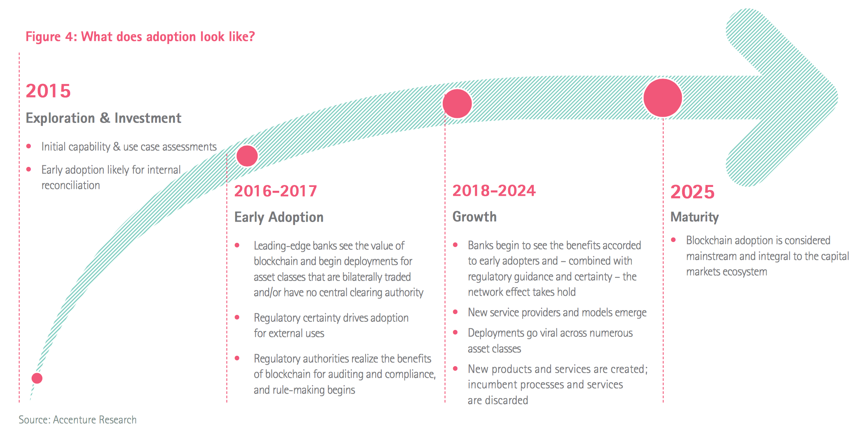
There is large interest in Blockchain Adoption, with many projects underway
Maersk | cargo tracking
Port of Antwerp | container handling
Walmart | supply chain transparency
Airbus | jet plane parts tracking
UPS | supply chain transparency
FedEx | customer dispute resolution
Australian Securities Exchange | clearance & settlement
Credit Suisse | syndicated loans
Dubai Land Dept. | land registry

Slide 10
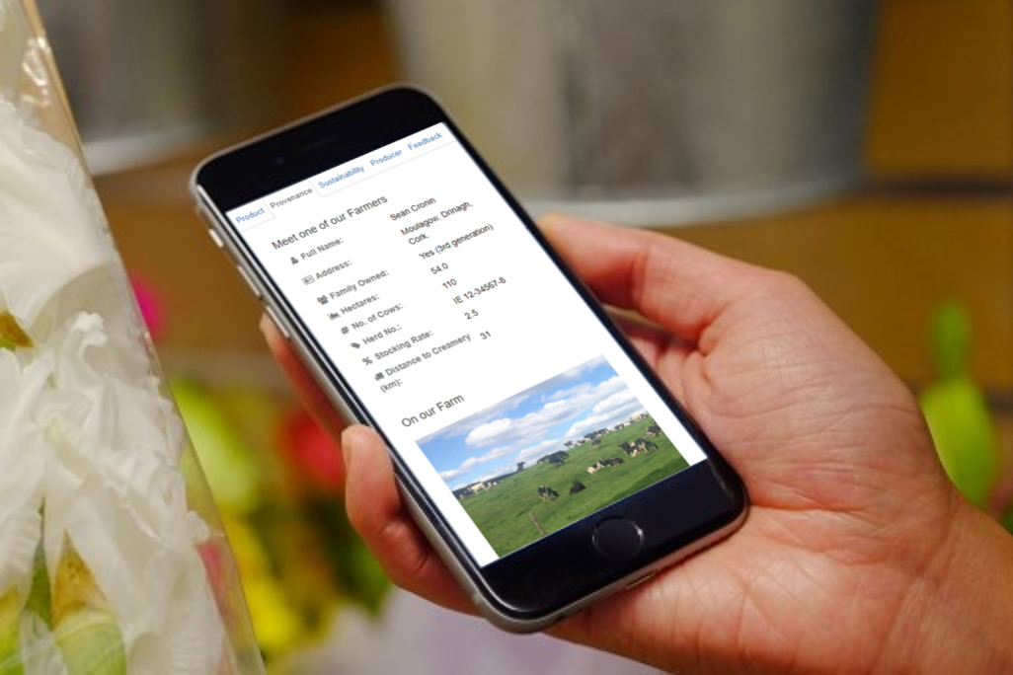
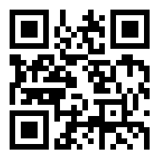

iLen is bringing Traceability to the Irish Dairy Sector
iLen.io
Notes:
Johannes

Slide 11

2) Deep Dive
source:
https://codeburst.io/deep-dive-into-electrons-main-and-renderer-processes-7a9599d5c9e2

Slide 12

Overview
Why so complicated?
Keys, Addresses
Transactions
Blocks
Consensus, Mining
https://melbournepsychooncology.com.au/overview/

Slide 13
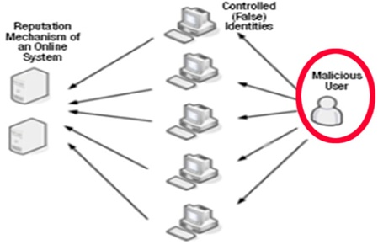
Why so complicated?
Distributed Systems are Hard
Consensus of Equal Peers
Malicious Actors suck!
Trustlessness
No Privileged Nodes to ask!
Challenges
Sybil Attack
Double Spend Attack
51% Attack
Bitcoin Whitepaper:
Economic Incentive, Game Theory
https://www.123rf.com/photo_45705087_genius-aged-teacher-explains-a-complicated-lesson.html
http://ablogaboutnothinginparticular.com/?p=3734

Slide 14
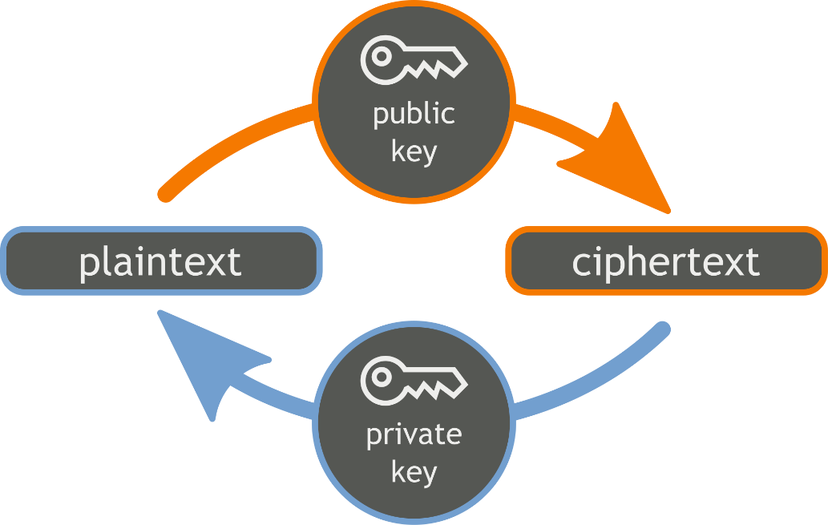
Keys, Addresses, Wallets
ECDSA
Generate Private Key
Private Key => Public Key
Public Key => Address
Key Generation (via casino dice ;) 25431526236113561513 31242434262415345565 22465166332621554513 55561166541223264111 6424635636524211655
Wallet
https://commons.wikimedia.org/wiki/File:Orange_blue_public_key_cryptography_en.svg

Slide 15
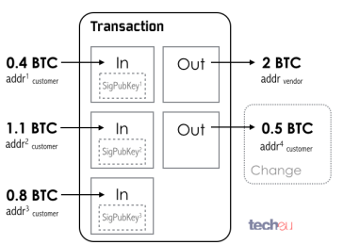
Transactions
Unspent Transaction Outputs (UTXO)
Multiple inputs/outputs
Inputs
Completely consumed
Signatures matching address
Outputs
Change Address for excess amount
Inputs - Outputs = Implicit Mining Fee
Note: Inputs should be > outputs, and signature is using PrivKey ;)
http://tech.eu/features/808/bitcoin-part-one/

Slide 16
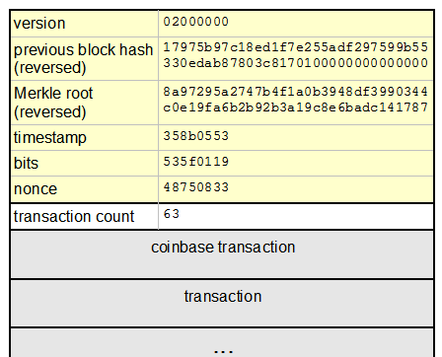
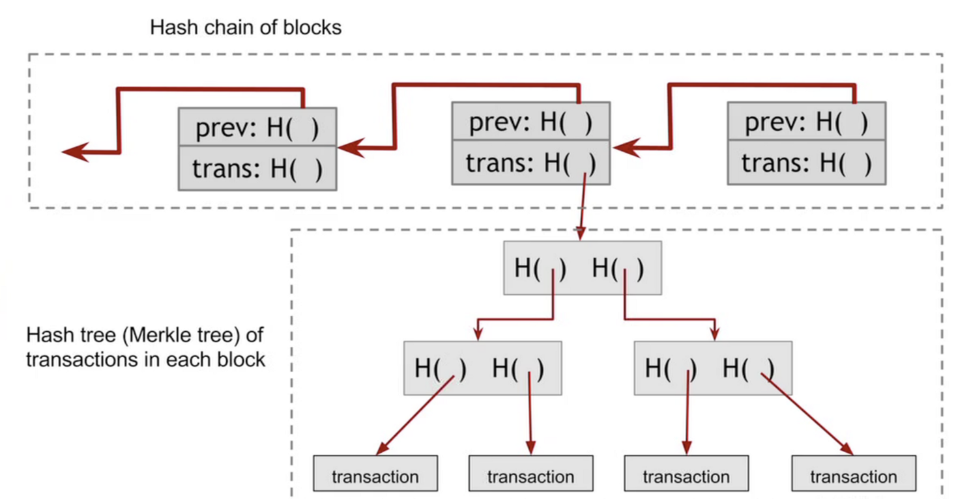
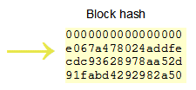
Blocks
images:
http://learningspot.altervista.org/bitcoin-blocks/
http://www.righto.com/2014/02/bitcoin-mining-hard-way-algorithms.html

Slide 17
Mining, Hash Puzzle
Hash Puzzle: Find Nonce, so that Block Hash < Diff. Threshold i.e. starting with 0x000000000004
Race to find solution to Hash Puzzle
Fair Lottery ~ Node Hashrate
Currently total: 25,000,000 TH/s
Block Reward = 12.5 BTC ~ $85,000
"Race Condition": Two blocks found within short time
Longest Chain wins
Wait 6 Confirmations (1h) to be sure
source: https://medium.com/@brettking/abc61b2ab49a

Slide 18
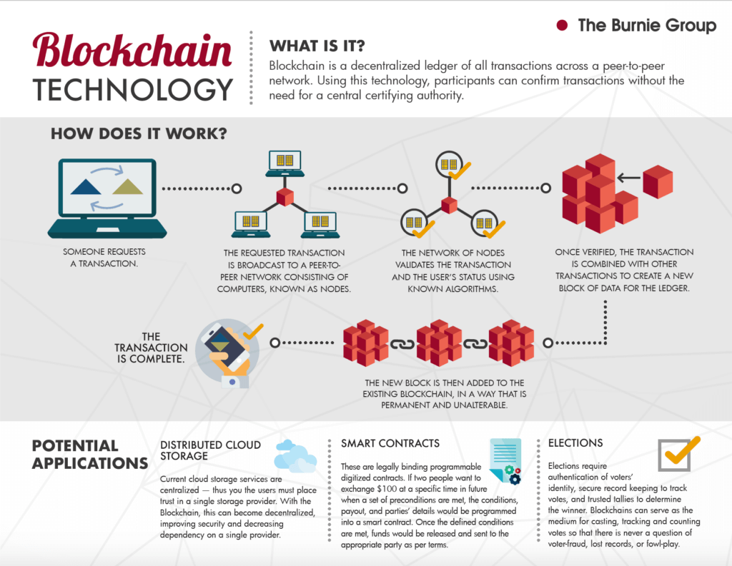
A day in the life of a Blockchain Transaction
source: https://www.burniegroup.com/infographic-a-look-at-blockchain-technology/

Slide 19
Do you want to know more?
Meetup: Cork Blockchain
Slides, Material on corkblockchain.com
Upcoming "Blockchain in Practice" Event at UCC June 19th => ilen.io
Good MOOCs
Coursera (Bitcoin and Cryptocurrency Technologies)
University of Nicosia (DFIN-511 Introduction to Digital Currencies)
Also offer MSc Digital Currencies
More Courses

Slide 20
Resources
Blockchain Explorer - https://blockchain.info/
Key Generation Toy - https://www.bitaddress.org
(obviously don't use a website for real keys)
Interactive Demo - https://blockchaindemo.io/
Another One from Bloomberg
Bitcoin Hashpower and Difficulty Chart
Bitcoin Energy Consumption
bitcoin ~ 6GW (depending on exchange rate)
1 nuclear power plant ~ 1GW

Slide 21
Thank you, any questions?
iLen.io

